Slide 1
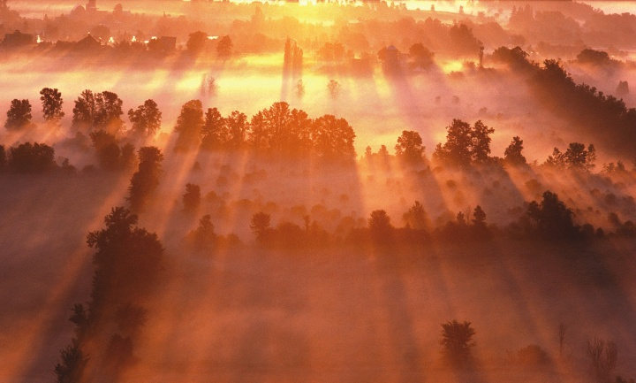
hqfoõ ux.,Hhka
bY%dfh,fha iy wfma m%Odk ux.,Hhka j, f;areu
ie,lsh hq;=h(w,q;a .sõiqï miqqìfï msgqq wxl w,qq;a .sõiqqï miqqìfï wdjrKh jk wxl j,g jvd fjkiah 136-137
Dr. Rick Griffith, Singapore Bible College
BibleStudyDownloads.org

Slide 2
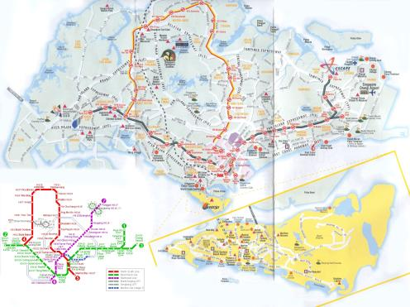
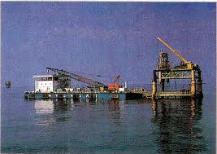
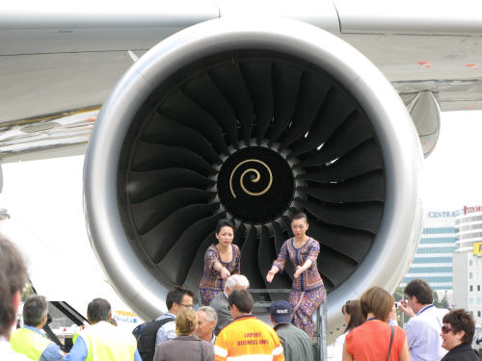

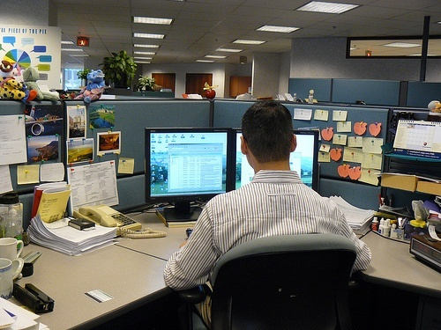
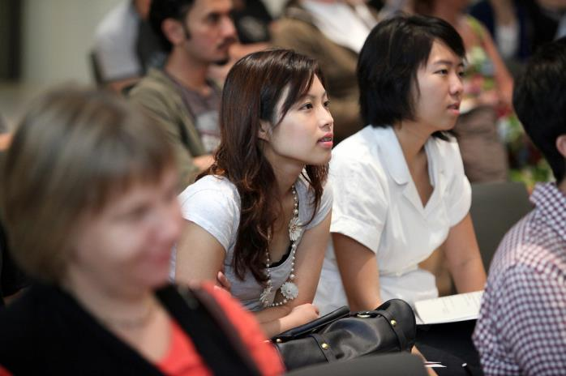



isx.mamqrefõ iodpdr m%;sm;a;s

Slide 3
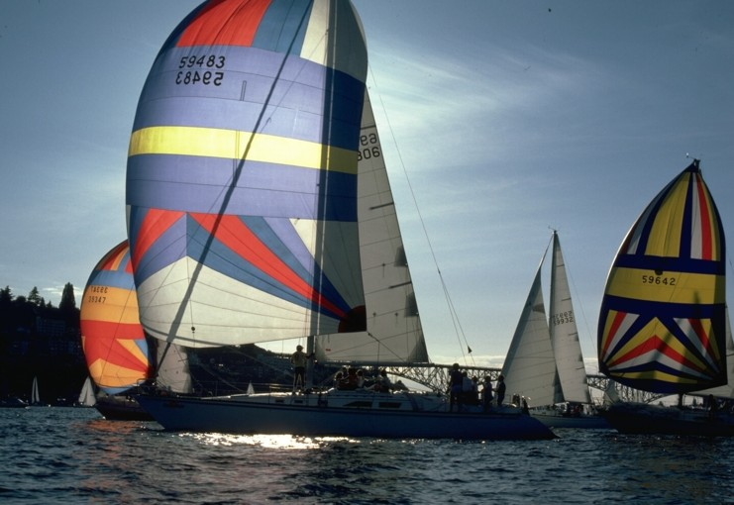
wehs ìoSula fjkafka@
179

Slide 4
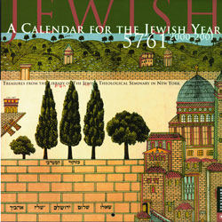
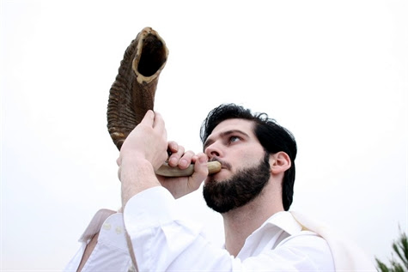
hqqfoõ le,ekavrh
180
wdpdr iïmkak
mQckSh
wxlsl

Slide 5

fyfn%õ le,ekavrh
kslauhdfï rd;%Sh
iajdñkajykafia ñir foaYfhaoS fudafiia iy wdfrdkag l:dfldg( fï udih kqU,dg udij, mgka.ekau jkafkah' tal kqU,dg wjqreoafoa m<uqfjks udih jkafkah'
kslauhdu 12(1-2
'
180
1 ksika
3 isjka
4 ;ïuqia
5 wdí
6 t,qq,a
7 áIars
8 u¾fniajdka
9 lsiaf,õ
10 fgfn;a
11 fInd;a
12 wo¾
2 bfh¾
mQckSh le,ekavrfha wdrïNh
wdpdr iïmkak le,ekavrfha wdrïNh
iema;eï¾
Tlaf;daïn¾

Slide 6

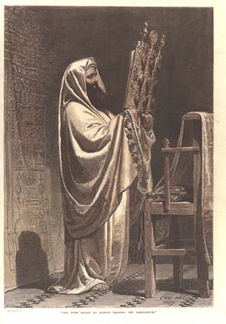

nhsn,fha ux.,Hhka
181
mrK .súiqug wkqj Y=oaO oskhka ieurSu

Slide 7
bY%dfh,a ux.,Hhkays ld, jljdkqj ^f,ù l:dj' 23&
184
oskh
ld,h
ux.,Hh
jeo.;alu ^w;S;fha&
o¾Ykjdoh ^wkd.;fha&
i;sm;d
1 oskhs
in;a
^in;a&
isysle|ùu
• foaj ueú,a,
• Bcsma;=fjka ñosu
ff;%hsudisl .súiqu
(kslauhdu 20, 31;^ oaús;sh l:dj 5)
iyY%h ( fyfn%õ 4(1-11
1-14
^ksidka&
1 oskhs
^.S;sld .dhkh&
Bcsma;=fjka .e,u neg,q
f,a mqcdj (kslauhdu. 12)
mdmfhka ïsosu msKsi
lzsia;=iaf.a mqcdj neg,qfjl= f,i
(1 fldrska;s 5:7b)
hqfoõ mdial=j ^fmidÉ&
1-15
isg 1-21
(ksidka)
fjkaõu' Bcsma;=j u;
wdrlaIKh yd foõhka jykafia u; wdrlaIKh"
osk y;hs
uqyqka fkdfhÿ
frdá
foõhka jykafia Wkajykafiag u wmj fjkalrf.k we;
(1 fldrska;s 5:7a, 8)
foõhka jykafiaf.a wkd.; wfmalaIdj jqfha wuqæjH imhï ireidr wiajekakls
1-16 (wiajekak ux.,Hhg
miqj tk in;a ^oskh)
1 oskhs
w.%M, ^nd¾,s ñáfha
ux.,Hh&
lzsia;=ia jykafiaf.a W;a:dkh
(1 fldrska;s 15:20)
fmka;fldia;
^YjqT;a&
^wiajekak&
1 oskhs
wiajekak fk,d .;a miq Wkajykafia Tng l, wdYs¾jdo wkqj wiajekak ux.,Hh mj;ajkak (^oaõ;sh l;dj 16:9-12)`
3-6
^isjdka&
lzsia;=ia jykafiaf.a
W;a:dkh iïsmq¾aK lrkq jia Y=oaOd;auhkaf.a meïsksu (lzshd 2)
^lshùu rE;a fmd;&

Slide 8
bYzdfh,a ux.,Hhkaj, ld,rduqj (f,ù 23
184
ld,h
ux.,Hh
jeo.;alu (w;S;fha)
oskh
(wkd.;fha)
mzs;sfha ux.,Hh
YS; ld<h
ux.,Hhka ke;
iNd j¾Ih
1 oskh
fydrKe yv
(w,q;a wjqreoao)
(frdIa yIdkd
cd;sl ksoyi ioyd
iQodkï ùu iy
mõ;zzslrKh mzzzshdiaÑ;a; oskfhaos
Tijd .eksu (^1 f;if,daksl 4(13&
t,sorõj (^uf;õ 24(31&
—rdcHh iQodkï lsrsu
7-1
(^;siars)
7-10
(^;siars)
1 oskh
jkaos f.ùfu(^fhï lsmamq&¾
ck;dj cd;sl
miq;eõ,a, yd mÑ;zzslrKh
mdmfhka(^f,õ l;dj. 16)
õmf;a os
bYzdfh,ajrekaf.a
miq;eõ,a,(^frdau 11(26-27)
7 oskhka j, lshùu,
(foaYkdldrhd)
uKavmhka*†
(uvq/l+vdrï)
(wOdr oSu)
(foõhka jykafia)
(wiajekak reialsrsu)
wnzyïf.a .sõiqfï
iïmq¾K õu
wfmalaId lrk ,os(^fkfyïhd 8)
wnzyïf.a .sõiqfuka
iïmQ¾K ùu
—rdcHh (^uf;õ 17:4)
7-15
isg 7-21
(^;siars)
7-22
(^;siars)
1 oskh
fiaïKs widfrÜ
(fgdardj lshùu)
" 8 osk ?iaùu"
“mzs;sùu fgdardfõ"

Slide 9
bYzdfh,a ux.,Hhka ys ld,jljdkqj(f,õ l;dj. 23)
184
oskh
ld,h
jeo.;alu (^miqj&
(wkd.;h)
my; ioyka oskhka Y=oaO ,shÑ,f,a wKlr ke; iy fmfkk wldrhg ld, jljdkqjlao ;snqfka ke;
5-9
(wíì)
1 oji
(lshõu ^õ,dm .S&)
9th of Ab
(Tish'ah be'ab)
fhrei,fu íojeásu
586 ls#mq & ls#j 70
9-25
(lsiaf,õ)
1 oji
+ 7 bÜmyka oe,aùfï oskhka
ykqld
(lemlsrsu)
(myka)
(osma;sh)
(ulÄjre)
tl, fcrei,fï lem lsrsfï ux.,Hh mj;ajkq ,eîh164 ls#mq
( fhdyka 10:22)
fï o¾jdos fld<u fmkajd fokjd bYzdfh,ajrekaf.a jd¾Isl ux.,Hhka yd weh cd;shla f,i ,enqjd jq w;aoelsu b;sydih mqrd
12-14/15
(wo¾&¾
2 ojia
(lshùï tia;¾)
mQrsï
(fldgi)
tia;¾ hgf;a cd;sh wdrlaId õh(9:21)

Slide 10
bYzdfh,a ux.,Hhkays fft;sydisl miqíu úuid ne,Su
180
1 ksika
2 bfh¾
3 isjka
4 ;ñuqia
5 wdì
6 t,q,a
7 áIars
8 u¾fniajdka
9 lsiaf,õ
10 fgfn;a
11 fInd;a
12wo¾ ¾
mdial=j
uqyqkakquqiq frá
mz:u t,
fmka;fldia;h
l+vdrï ux.,Hh
jkaos f.ùfï oskh
fydrKe yv
3 jkaokd ux.,Hhka

Slide 11
ux.,Hhka fy<s lrk bYzdfh,a jrekaf.a wkd.;h
180
1 ksika
2 bfh¾
3 Sisjka
4 ;ïuqia
5 wdí
6 t,q,a
7 ázIaars
8 u¾fniajdka
9 lsiaf,õ
10fgfn;a
11 fInd;a
12 wo¾
ñoSu
mdial=j
uqyqkakquqiq frdá
fjkaùu
mz:u M,
kej; ke.sàu
fmka;fldia; oskh
wd;auh
foaj rdcHh
l=vdrï ux.,Hh
miq;eú,sùu
jkaosf.úfï oskh
Tijd.ekSu
fydrKe yv
3 jkaokdfjs ux.,Hhka

Slide 12
I. foúshka jykafia iu. Y=oaO .ukla fjkqfjka bYzdfh,ajre úfõl .;ay
180
    A. foaj wdYs¾jdoh ;=, rodmj;skq msKsi ish,q hqfoõ mqreIhka jd¾Ysl ux.,Hhka ;=klg iyNd.s úh"( kslauhdu ^23:14-19).

Slide 13
mdial=j jkaokd ux.,Hh #1
180
1 ksika
2 bfh¾¾
3 isjka
4 ;ñuqia
5 wdí
6 t,q,a
7 ;sIaars
8 u¾fniajdka
9 lsiaf,ú
10 fgfn;a
11 fInd;a
12 wo¾¾
mdial=j
ñosu
uqyqkakquqiq frdá
fjkaùu
mzz:u t,
kej; ke.sàu
3 jkaokd ux.,Hhka

Slide 14
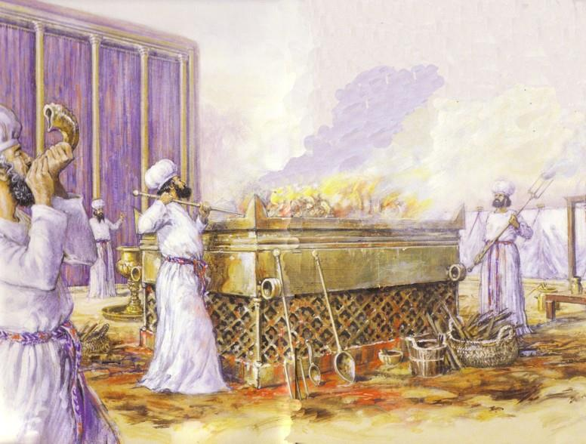
ks;ru hqfoõsjka iïmq¾aK ojk mqcdjka mj;ajk ,os

Slide 15

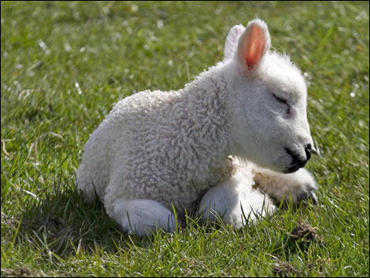
mdial= neg,qjd
"… kqU,d uq,q bYardfh,a cd;sh wu;d fufia ksfõokh l,hq;=h" fï udifha oijk osk yeu ñsksfilau tla f.orlg negM megfjl= imhd.; hq;=h" ^kslauhdu 12-3)

Slide 16

mdial=fõs wrlaIdj
kqU,d isásk f.j,a u; ;jrd we;s f,a kqU,d tajdfha isák njg ,l=Kla jkafkah " uu f,a olsk úg kqU,d miq lr hkafkñs" ta udrl oXqju kqU,d fj; fkdmeñsfkkq we;"
kslauhdu 12:13 (NIV)

Slide 17
weoys,a, Ñ;%h
udr ¥;hd Tjqkaf.a l=,q≥,ka úkdY fkdlrk msKsi Tyq mdial=j yd f,a bisu o weoys,af,ka meje;aúh"¨¨
fyfn%õ 11:28 (NIV)

Slide 18
neg,qjdf.a rEmh
miq osk fhdyka f;fï fhaiqia jykafia ;ud iómhg jãkq oel" ’fukak f,dalfha mdmh oqr,k foúhka jykafiaf.a negM¨ fmda;lhdfKda
fhdyka 1:29 (NIV)

Slide 19
l=reish
wmf.a mdial= neg,qjd f,i lzsia;=iajykafia mqcdù ;sfí'
1 fldrska;s 5:7 (NIV)

Slide 20

weoys,af,a neg,q meáhdfKda

Slide 21

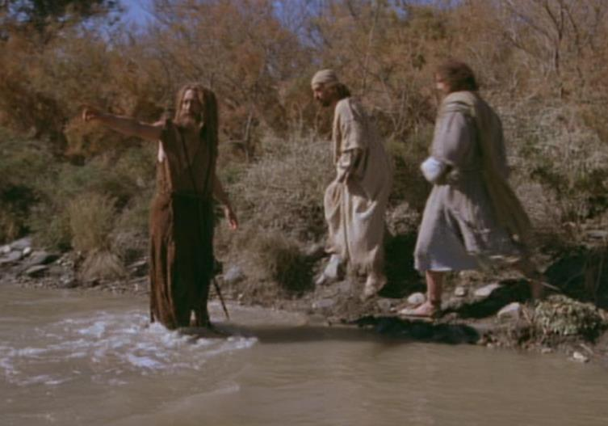
mdial= neg,qjd
"miq osk fhdyka f;fï fhaiqia
jykafia ;ud fj;g jÙkq oel' ’fukak f,dalfha mdmh ≥r,k foúhka jykafiaf.a negM fmda;lhdfKda " (fhdyka 1:29)

Slide 22

“fïs uf.a isrerh…"

Slide 23

urKfha foaj≥;hd fodrj,ays f,a ;jrd we;s ksfjia miq lr .shy'

Slide 24
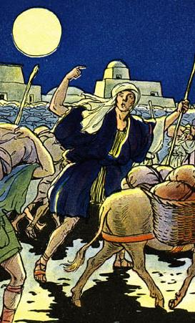
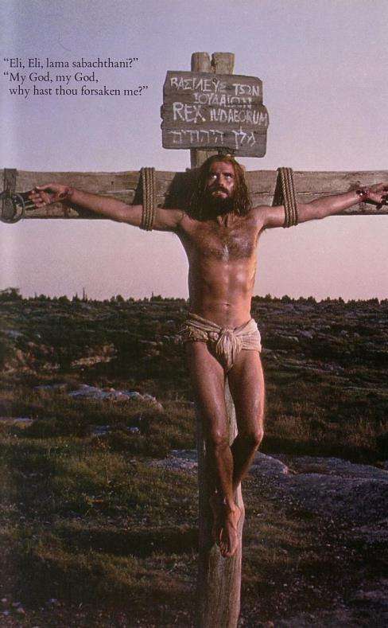
fmd≥ in|;djh
kslauhdu fjhs mrK .súiqu
l=reish fjhs kj .súiqu
.e,ùsu

Slide 25
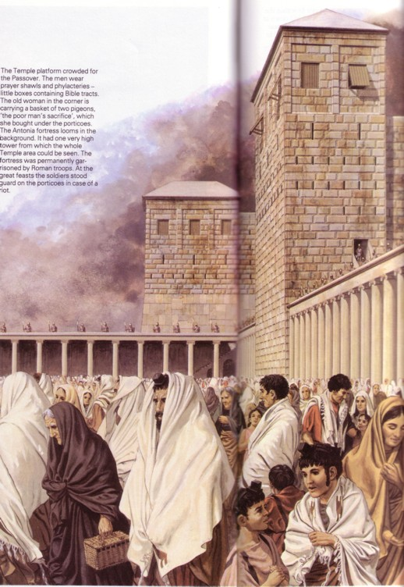

w,q;a .súiqfï mdial= W;aijhkag 100,000 hqfoõjka foajud,s.djg meñsK we;

Slide 26
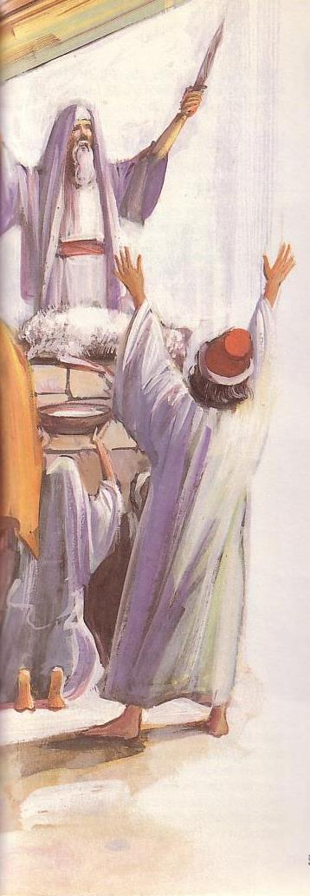
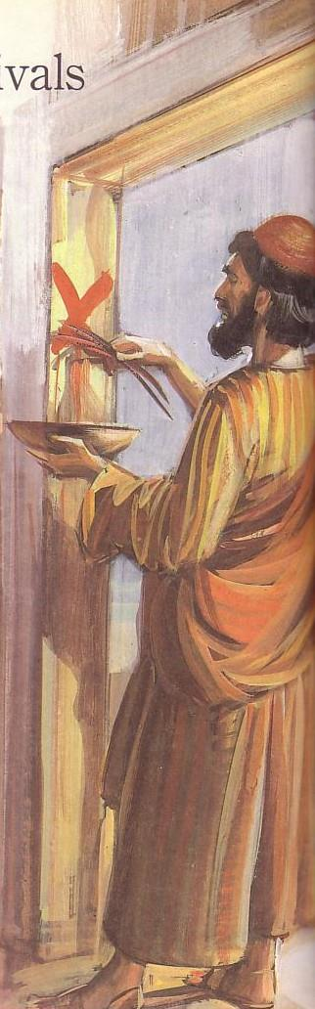
mdial=fjka miq ms<sìsUqj
184

Slide 27
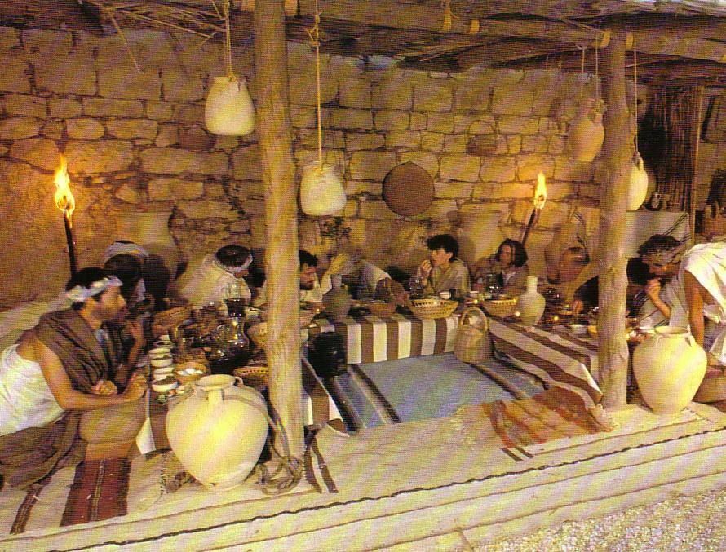
fhaiqia jykafia mdial=j ieurSug yso isásk whqre

Slide 28
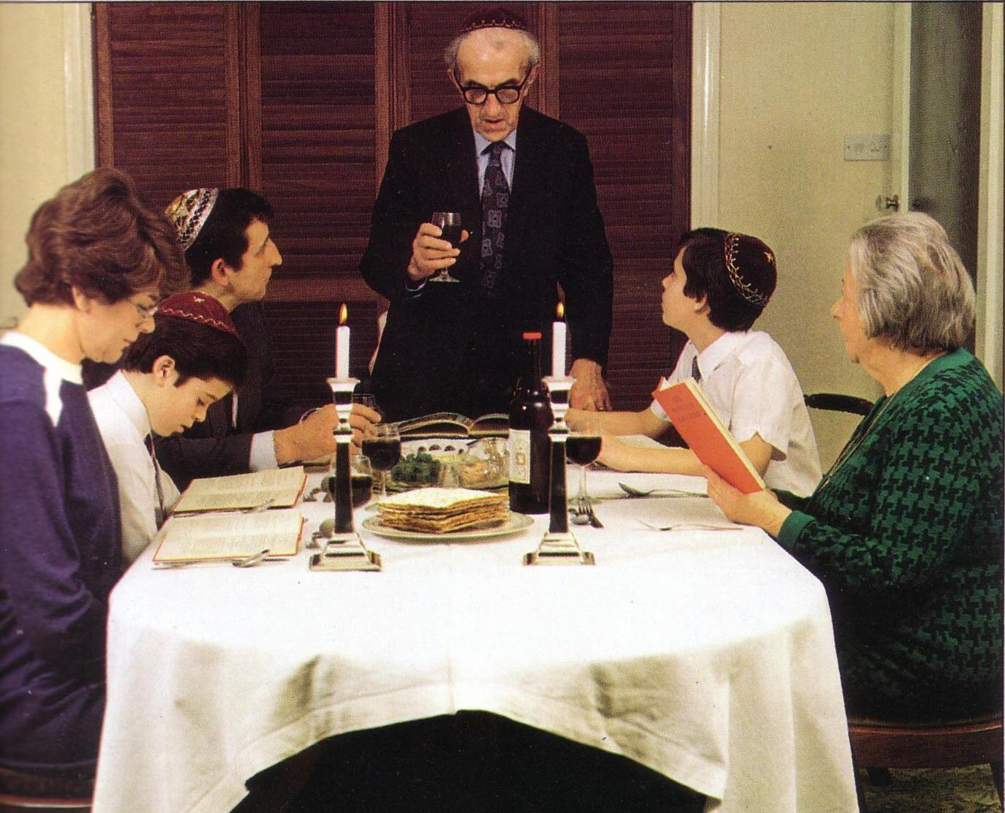
kQ;k mdial=j iurk wldrh

Slide 29
mdial=j jkaokd ux.,Hh #1
180
1 ksidka
2 bfh¾
3 isjka
4 ;ñuqia
5 wdí
6 t,q,a
7 ;sIars
8 u¾fniajdka
9 lsiaf,ú
10 fgfn;a
11 fInd;a
12 wo¾¾
mdial=j
.e,ùu
uqyqkakquqiq frdás
fjkaùu
3 jkaokd ux.,Hhka

Slide 30

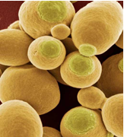

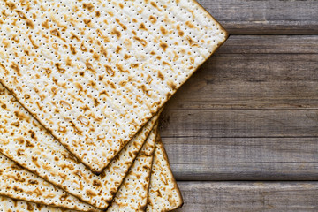
uqyqkakquqiq frdá ux.,Hh
184
Notes:
www.stephenwilliamson.com/ Hobbies/bakin.htm (Yeast bloom)

Slide 31
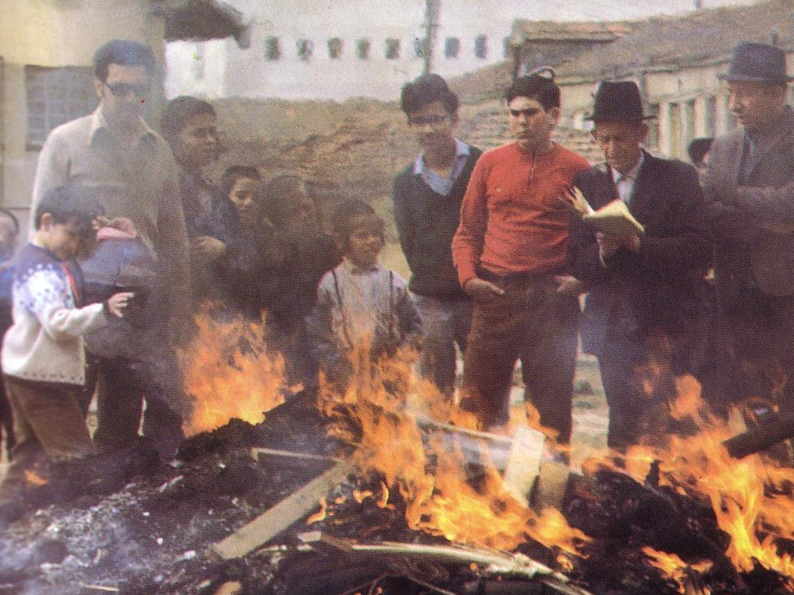
¸ish,q uqyqka ms<siaiSu!"

Slide 32
mdial=j jkaokdfõ ux.,Hh #1
180
1 ksika
2 bfh¾
3 isjka
4 ;ñuqia
5 wdí
6 t,q,a
7 ;sIars
8 fniajdka
9 lsiaf,õ
10 fgfn;a
11 fInd;a
12 wo¾¾
mdial=j
.e,ùu
uqyqkakquqiq frá
fjkaùu
mzz:u t,
W;a:dkh
3 jkaokd ux.,Hhka

Slide 33
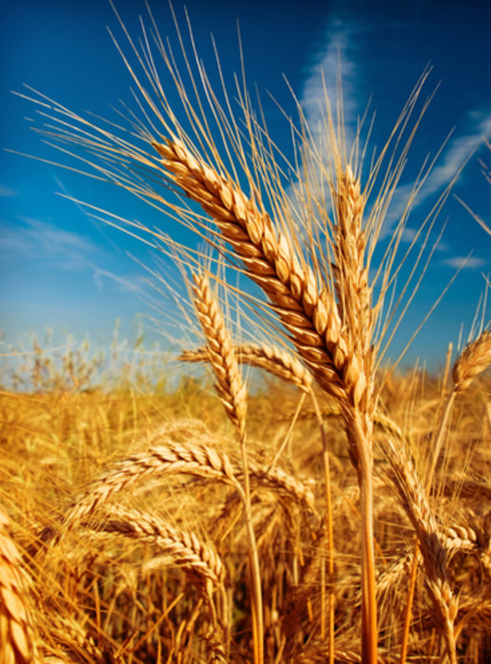
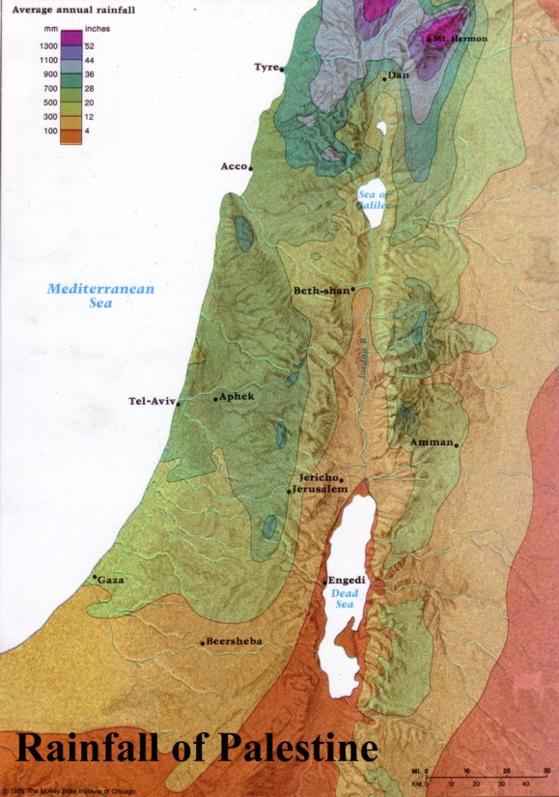
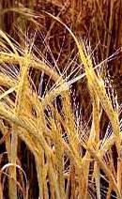
mz:u M, f.dhï ñáh jkñka meñK mqcdlsrSu
184
≥rska msysá W;=re bYzdh,fha wiajekak
my, msysá fhrei,ug f.k tau

Slide 34
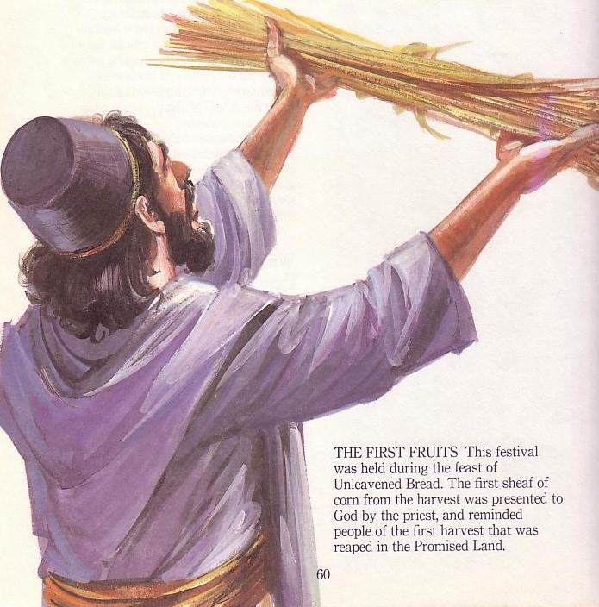
mz:u M, foaj ud,s.djg mqcd lsrSu
184
≥rska msysá W;=re bYzdfh,fha wiajekak
my,ska msysá fhrei,ug f.k tau
foúhka jykafia bosrsmsg mqcd lsrSu

Slide 35

wkd.;h fy<slrk i;s wka;hla
nzyiam;skaod
isl=rdod
fikiqrdod
brsod
.,S,h
mdial=j
uqyqkakquqiq frdá
mz:u t,,
cqohdj
mdial=j
uqyqkakquqiq frdá
mz:u M,
wjika fNdackh
l=reis mqcdj
W;a:dkh
Notes:
Leviticus 23 gives the order of three key feasts of Israel: • Passover, • Unleavened Bread, and • Firstfruits.
• But how could Jesus have Passover Thursday night but then die at 3 PM the next day on Friday when the Passover lambs were being slaughtered? And why did the Jewish leaders want the bodies off the cross quickly as Passover was approaching when Jesus had already celebrated Passover the night before?
• The answer is that Galilean Jews celebrated Passover the day before • Judean Jews. Since his disciples were Galileans, Jesus naturally celebrated on their timetable.
The Feast of Unleavened Bread always began the day after Passover (Lev 23:5-6). Then Firstfruits followed sometime later on the first Sabbath after the first crops began to ripen (Lev 23:11). It indicated that millions of additional sheafs would follow until the entire harvest came in at Pentecost. In AD 33, these three celebrations occurred one after another on three consecutive days!
The significance is astonishing. • Christ predicted his death at the Last Supper Thursday night. • Then Jesus died on the Judean Passover • so that believers can live a life without yeast (Unleavened Bread), • which immediately followed with his resurrection on Firstfruits as he is the first and only human ever to obtain a glorified body as an installment for millions more to follow (1 Cor 15:20)!

Slide 36
fmka;fldia;: jkaokd ux.,Hh #2
180
1 ksika
2 bfh¾¾
3 isjka
4 ;ñuqia
5 wdí
6 t,q,a
7 ;sIars
8 fniajdka
9 lsiaf,õ
10 fgfn;a
11 fInd;a
12 wo¾¾
mdial=j
ñosu
uqyqkakquqiq frdá
fjkaùu
mzz:u t,
W;a:dkh
fmkalfldia;h
wd;auh
3 jkaokd ux.,Hhka

Slide 37
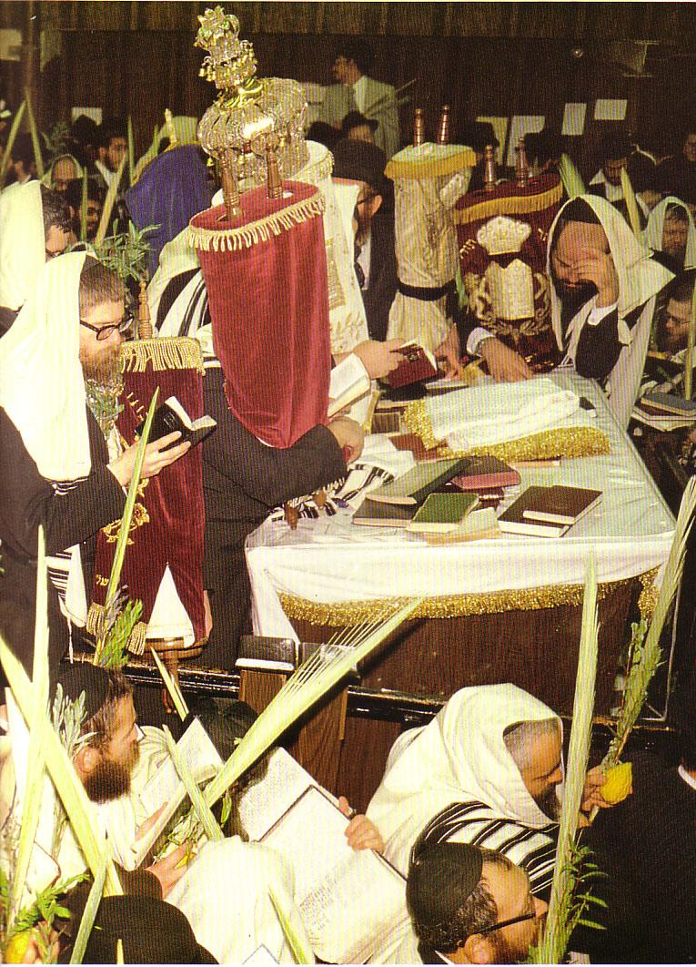

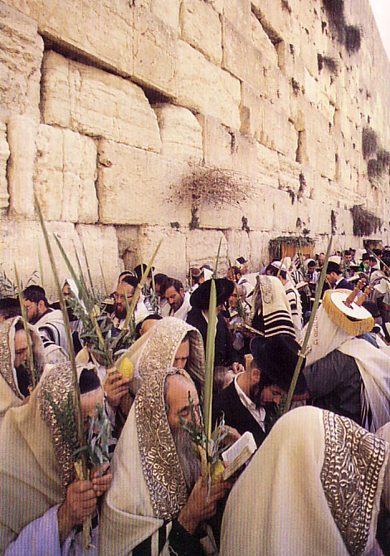
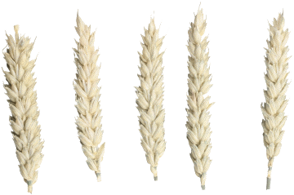
wiajekak ux.,Hh iurñska

Slide 38
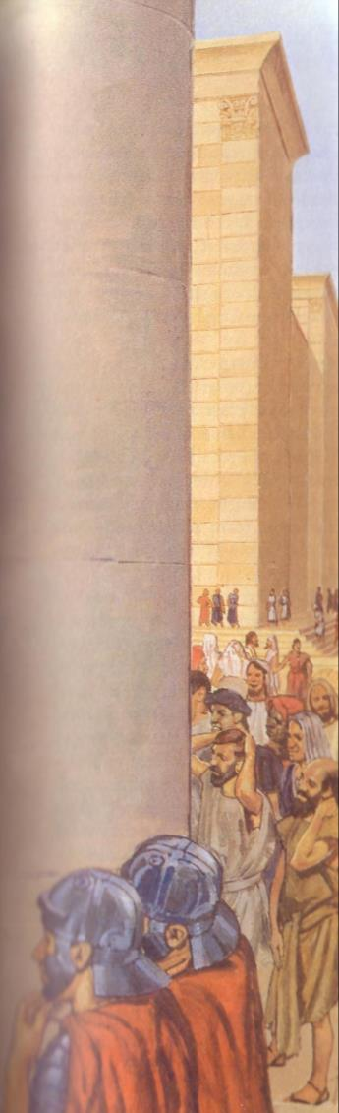
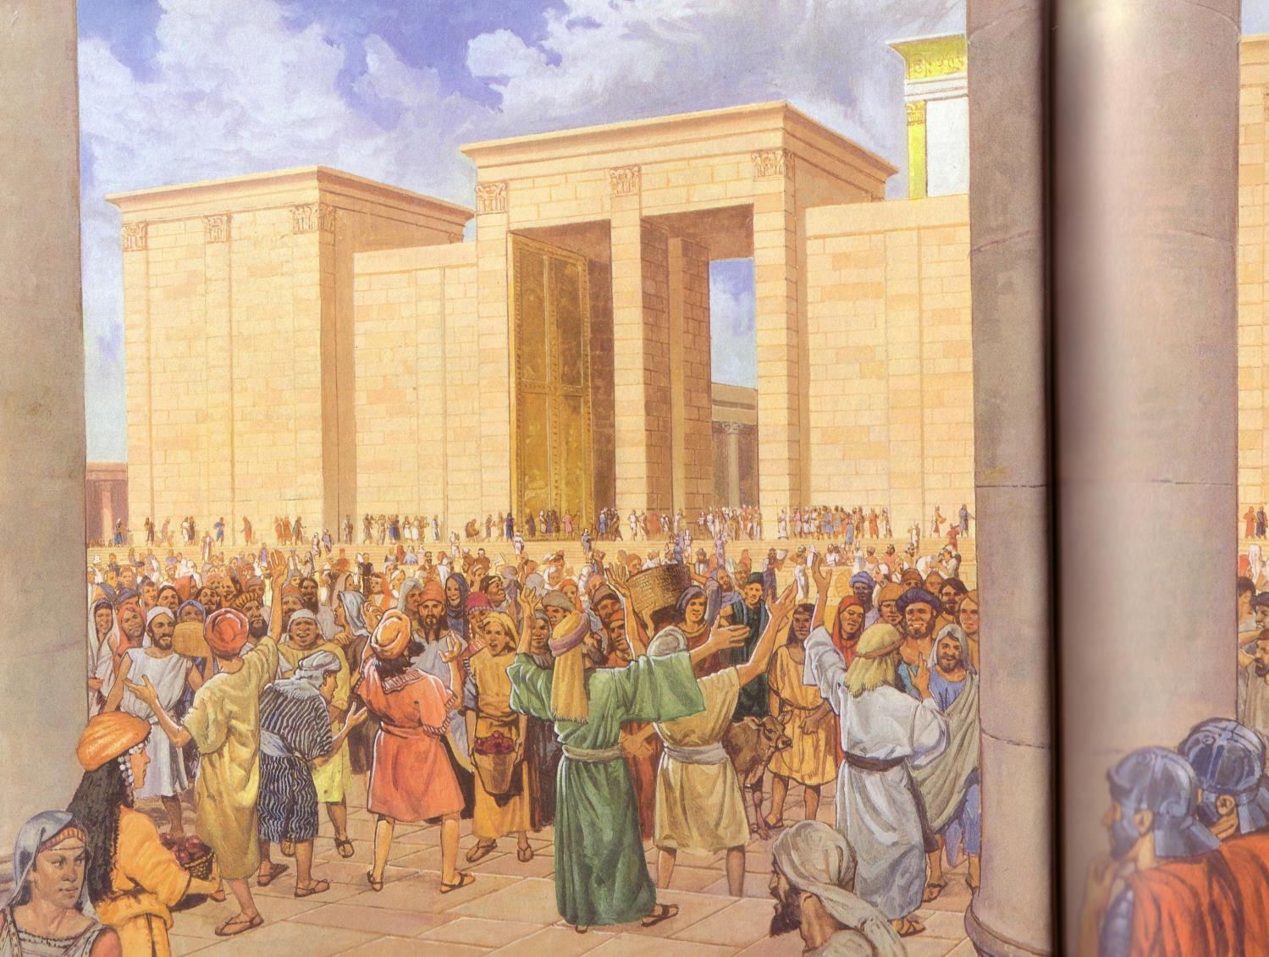
lsis oskl bf.k fkd.;a NdIdj,ska wfmdia;=,qjre foúshka jykafiag mzixYd l,y(^lzshd 2)

Slide 39
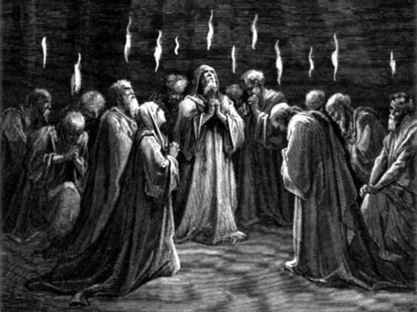
fmka;fldia; osk Y=oaOd;auhdKka jevu l,y(^lzshd 2)

Slide 40
f,ù 23 ux.,Hhka
180
1 ksika
2 bfh¾
3 isjka
4 ;ñuqia
5 wdí
6 t,q,a
7 ;sIrs
8 u¾fniajdka
9 lsiaf,õ
10 fgfn;a
11 fInd;a
12 wo¾¾
mdial=j
.e,ùu
uqyqkakquqiqq frá
fjkaùu
mzz:u M,
W;a:dkh
fmka;fldia;h
wd;auh
Tijd .ekSu
fydrKe yv
3 jkaokd ux.,Hhka

Slide 41
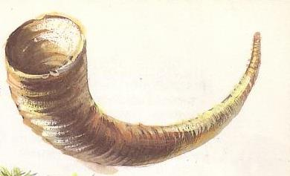
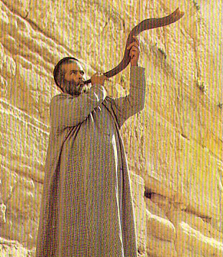
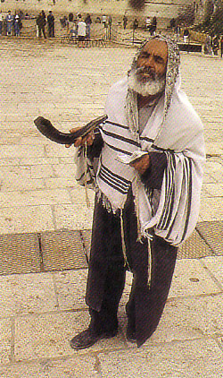
frdIaa yIdkd(^w,q;a wjqreoao)
184
Notes:
http://images.google.com/imgres?imgurl=www.rigal.freeserve.co.uk/jewish/calendar/calenda2a.gif&imgrefurl=http://www.rigal.freeserve.co.uk/jewish/calendar/jcalendar2.htm&h=398&w=477&prev=/images%3Fq%3DJewish%2BCalendar%2BDiagram%26svnum%3D10%26hl%3Den%26lr%3D%26ie%3DUTF-8%26oe%3DUTF-8

Slide 42
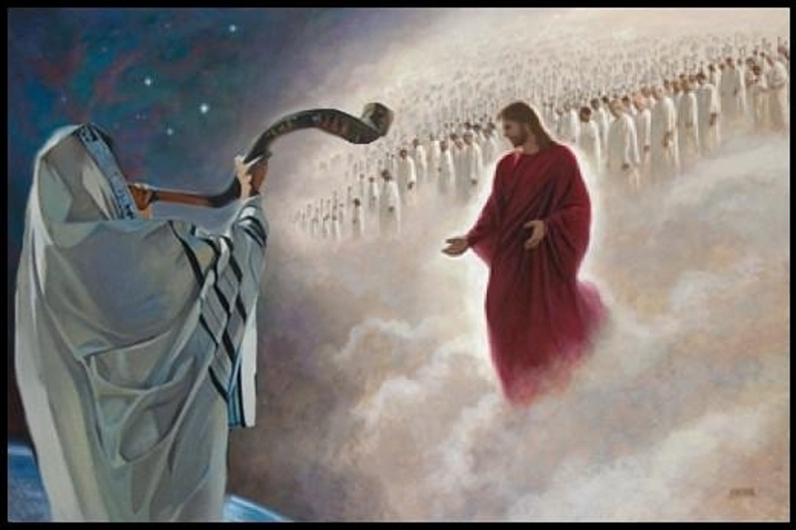
Rosh Hashanah (New Year)
184
Notes:
The trumpet sound at the Jewish New Year (Rosh Hashanah) is often associated with the return of Christ. Both the Rapture before the Tribulation (1 Thess 4:16) and the Second Coming at the end of the Tribulation (Rev 19:11).
Rapture:
1Th. 4:16 For the Lord himself will come down from heaven with a commanding shout, with the voice of the archangel, and with the trumpet call of God. First, the Christians who have died will rise from their graves.
Some also add (though I do not) Rev. 4:1 Then as I looked, I saw a door standing open in heaven, and the same voice I had heard before spoke to me like a trumpet blast. The voice said, “Come up here, and I will show you what must happen after this.”
Second Coming:
Matt. 24:31 And he will send out his angels with the mighty blast of a trumpet, and they will gather his chosen ones from all over the world—from the farthest ends of the earth and heaven.
1Cor. 15:52 It will happen in a moment, in the blink of an eye, when the last trumpet is blown. For when the trumpet sounds, those who have died will be raised to live forever. And we who are living will also be transformed.

Slide 43
f,ú l;dj 23 ux.,Hhka
180
1 ksika
2 whsh¾¾
3 isjka
4 ;ïuqia
5 wdì
6 t,q,a
7 ;sIars
8 fÑiajdka
9 lsiaf,ù
10 fgfn;a
11 fInd;a
12 wo¾¾
mdial=j
ñoSu
uqyqkakquqiq frdÜ
fjkaùu
mzzz:u t,
W;a:dkh
fmka;fldia;h
wd;auh
miqq;eú,a,
jkaos f.õfï oskh
Tijd .eksu
fydrKe yv
3 jkaokd ux.,Hhka

Slide 44
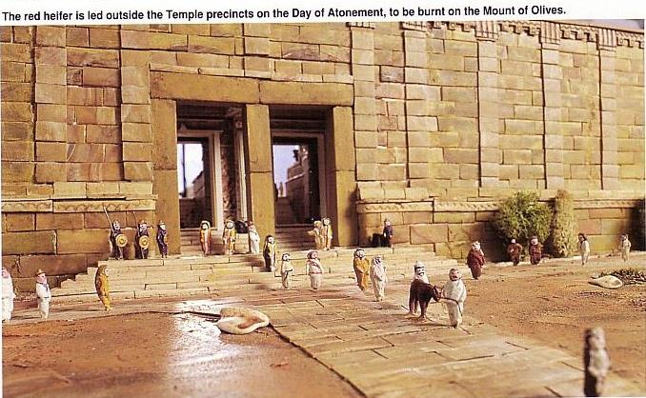
jkaos f.jd ksoyia ùfï oskh
184
r;= jeiaish foaj ud,s.dfjka f.k jq;a T,Sj lkao u; ojk mqcdjla f,i mqcd lsrsu

Slide 45
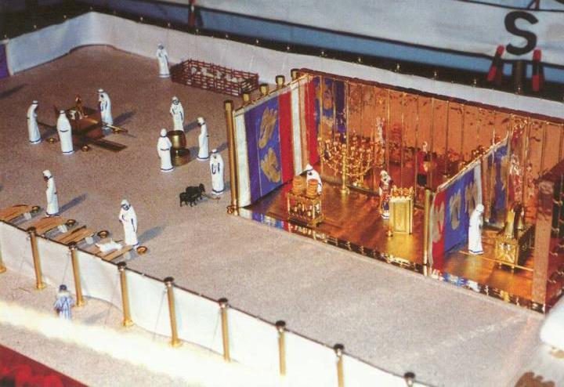
msrsis≥ùfïs oskh( f,ú l;dj. 16:29-34)
u,qj
Y=oaOia:dkh
w;s Y=oaOia:dh

Slide 46
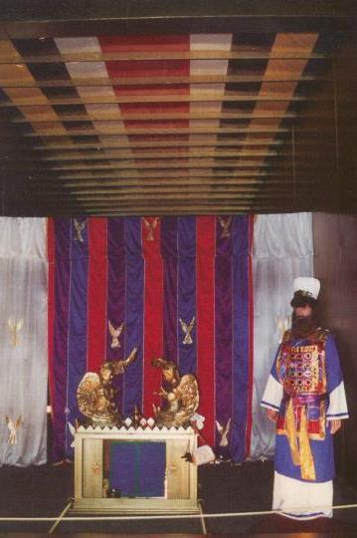
wdf,amfha oskh
mqclhdf.a iqodkïùsu
mqclhdf.a mdm mqcdj
ck;djf.a mdm mqcdj
msrsis≥ùsu
f,ú l;dj16:29-34

Slide 47
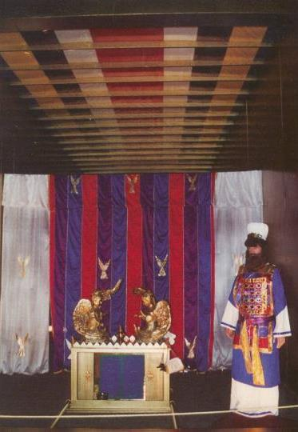
jkaos f.úfï oskfha ixfla;kh
tfy;a lzsia;=ia jykafia oekg u we;s hym;a foa ms<sno W;a;u mqclhdkka jYfhka meñK isák fial’ Wkajykafia jvd W;=ï yd jvd iïmq¾K ñksia w;ska fkdie≥‘ tkï fï fN!;sl ueú,a,g whs;s fkdjk uKavmfha mQclhdfKdah"
fyfnzõ9:11 (NIV)

Slide 48
tla jrla Tyqf.a reêr mqcdj ish,a,ka fjkqfjka
Wka jykafia t¿jkaf.a;a jiaikaf.a;a f,hska fkdj ;ukaf.a u f,hska wm Wfoid iod;k úuqla;sh ,nd ioyg u tl jrla Y=oaOia:dkhg we;=¿ jq fial'
fyfn%õ 9:12 (NIV)

Slide 49
;j ≥rg;a jkaos f.ùula wjYHh ke;
kdhl mqclhd wkqkaf.a f,a /f.k wjqre≥ m;d Y=oaOia:dkhg we;=,q jkakdla fuka Wkajykafia kej;;a ;uka u Tmamq lrk msKsi we;=t fkdjq fial'
fyfnzú 9:25 (NIV)

Slide 50
mdmh bj;a lsrsu iu.( ^jeiaula ke;&
tfia fkdjqfjkï " f,dalh ueúfï mgka fkdfhla jr" Wka jykafiag jo fõokd úosu wjYH jkq we;' tfy;a Wka jykafia ;uka u mQcd lsrsfuka mdmh oqre lrk msKsi fï hq.dka;fha oS ioyg u tl jrla mzldY jq fial'
fyfnzú 9:26 (NIV)

Slide 51
Y=oaOia:dkfha wdikhla?
tfy;a Wka jykafia mõ Wfoid ioyg u tl u mqcdjla Tmamq fldg " foúhka jykafiaf.a ol=Kq mi wiqka .;a fial"
fyfnzõ 10:12 (NIV)

Slide 52
l+vdrñ jkaokd ux.,Hh #3
180
1 ksika
2 bfh¾¾
3 isjka
4 ;ñuqia
5 wdí
6 t,q,a
7 ;sIrs
8 u¾fniajdka
9 lsiaf,ú
10 fgfn;a
11 fInd;a
12 wo¾¾
mdial=j
ñoSu
uqqyqkakquqiq frdá
fjkaùu
mzz:u t,
W;a:dkh
fmka;fldia;h
wd;auh
l+vdrñ ux.,Hh
miq;eú,a,
mzzhdiaÉ;a;h
Tijd .eksu
fydrKE yv
3 jkaokd ux.,Hhka

Slide 53
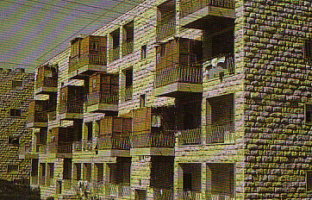




l+vdrï ux.,Hh
184
f,ú l;dj 23:42-43 “y;a oskla u kqU,d me,am;a j, jdih l, hq;=h" bYzdfh,a cd;slhka ish,q fok fufia úish hq;=h" fuf,i ud bYzdfh,a ckhd ñir foaYfhka msg;g f.fkk úg ud Tjqkag me,am;aj, jdih lrkag ie,iq nj kqU,df.a wkd.; mrñmrd oek.kafkdah"a
l+vdrï(wdjrKh)

Slide 54
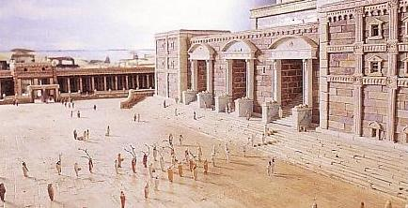
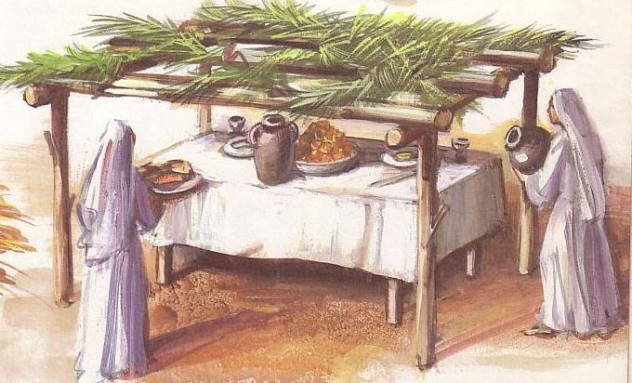
l+vdrï ux.,Hh
184
oaaõ;Sh l;dj 16:13 “Tfì OkOkH iy ños Tn tl;= l,dhska miq" osk y;la Tn l+vdrñ ux.,Hh meje;aúh hq;=h"

Slide 55

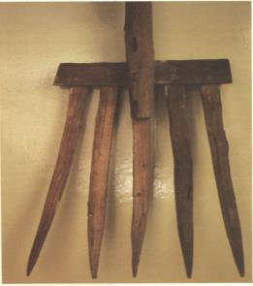
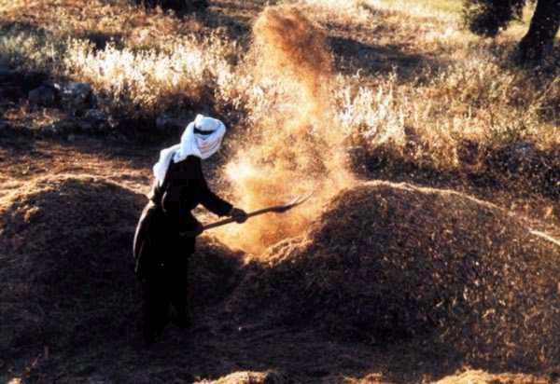
l+vdrï ux.,Hh" wka;su wiajekak
184
yq,xlsrsu = lzsia;=ia jykafia kej; fmdf<djg meñKsu
cd;Skaf.a úksYajh (uf;õ 13:30, 39; t,sorõ. 14:15)
rEm úm¾hdih = foaj rdcHh wkq.ukh (uf;õ. 17:4)

Slide 56
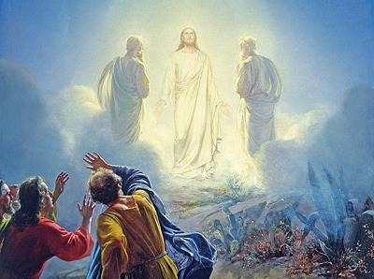
rEm úsm¾hdih = l+vdru = foaj rdcHh(^uf;õ. 17:4)

Slide 57
l+vdrñ: jkaokd W;aijh #3
180
1 ksika
2 bfh¾
3 isjka
4 ;ñuqia
5 wdí
6 t,q,a
7 ;sIars
8 u¾fniajdka
9 lsiaf,ú
10 fgfn;a
11 fInd;a
12 wo¾¾
mdial=j
ñoSu
uqqyqkakquqiq frá
fjkaúu
mzzzz:u t,
W;a:dkh
fmka;fkia;h
wd;auh
rdcHh
l+vdrï
miq;eú,a,
jkaos f.ùfu oskh
Tijd .eksu
fydrKE yv
3 jkaokd ux.,Hhka

Slide 58
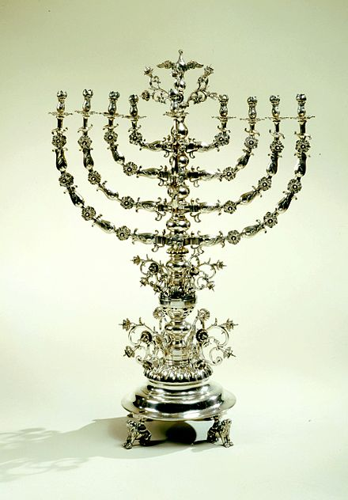
bYzdfh,a ux.,Hhka ys idrxYh
183
A. udi follg j;djla /iaúh
B. mzs;sh yd oql
C. fhrei,fïos yd ksjfiaos
D. lDIsld¾ñl ie,iqï

Slide 59
bia;rñ wiajekak wmzsfh,a -fkdjeïn¾¾
183
kQ;k lDIsld¾ñl lzu Ndú;d lrñka wiajeoaosu yd wiajekak fk,d .eksu bYzdfh,h isoq lrhs
 | ud¾;= | wmzzsfh,a | uehs | cqks | cQ,s | wf.daia;= | iema;eïn¾ | Tlaf;daïn¾ | fkdfjïn¾
brs.= |  |  | X
nd¾,s |  | X
OkH j¾.hls |  |  | X
uqx weg |  | X | X
lv, |  |  |  | X
uhsiq¾ mrsmamq |  | X | X
uE j¾.ls |  | X | X
;, |  |  |  |  | X
nq.eáh |  |  |  |  | X
fufkars |  |  |  |  | X | X
ños |  |  |  | X | X | X | X
w;a;slald |  |  |  |  |  | X | X
foΩï |  |  |  |  |  | X | X
T,sõ |  |  |  |  |  |  | X | X | X
rdcHh
http://www.wcg.org/lit/law/festivals/harvest.htm
Notes:
http://www.wcg.org/lit/law/festivals/harvest.htm

Slide 60
bYzdfh,a ux.,Hhka ys idrxYh
183
A. udi foll os /iaùu
B. fhrei,fïos yd ksjfiaos
C. lDIsl¾uh u; flakaø.; ùu
D. cd;sh tlai;a ùu
E. úfõlh imhk ,os
F. w;S;h yd wkd.;h foi ne,su

Slide 61
Y=oaO ,shús,af,a wK lr fkdue;s fjk;a ux.,Hhka ;=k

Slide 62
wu;r nhsn,sh ux.,Hh #1
180
1 ksika
2bfh¾
3 isjka
4 ;ñuqia
5 wdí
6 t,q,a
7 ;sIrs
8 u¾fniajdka
9 lsiaf,õ
10 fgfn;a
11 fInd;a
12 wo¾¾
mdial=j
ñosu
uqyqkakquqiq frdá
fjkaùu
mzzz:u t,
W;a:dkh
fmka;fldia;h
wd;auh
rdcHh
l+vdrñ ux.,Hh
9th of Avu
miq;eú,a,
jkaos f.ùfu oskh
Tijd .eksu
fydrKe yv
3 jkaokd ux.,Hhka

Slide 63

wjqreoq 400 ld<hla hqfoõ csú; i,fudkaf.a foajud,s.dj jgd neos ;snqkdy (959-586 lzs(mq)
bYzdfh,ays hqfoõ wd.u yd vhiafmdardj(^fkdlvjdu&)
184

Slide 64
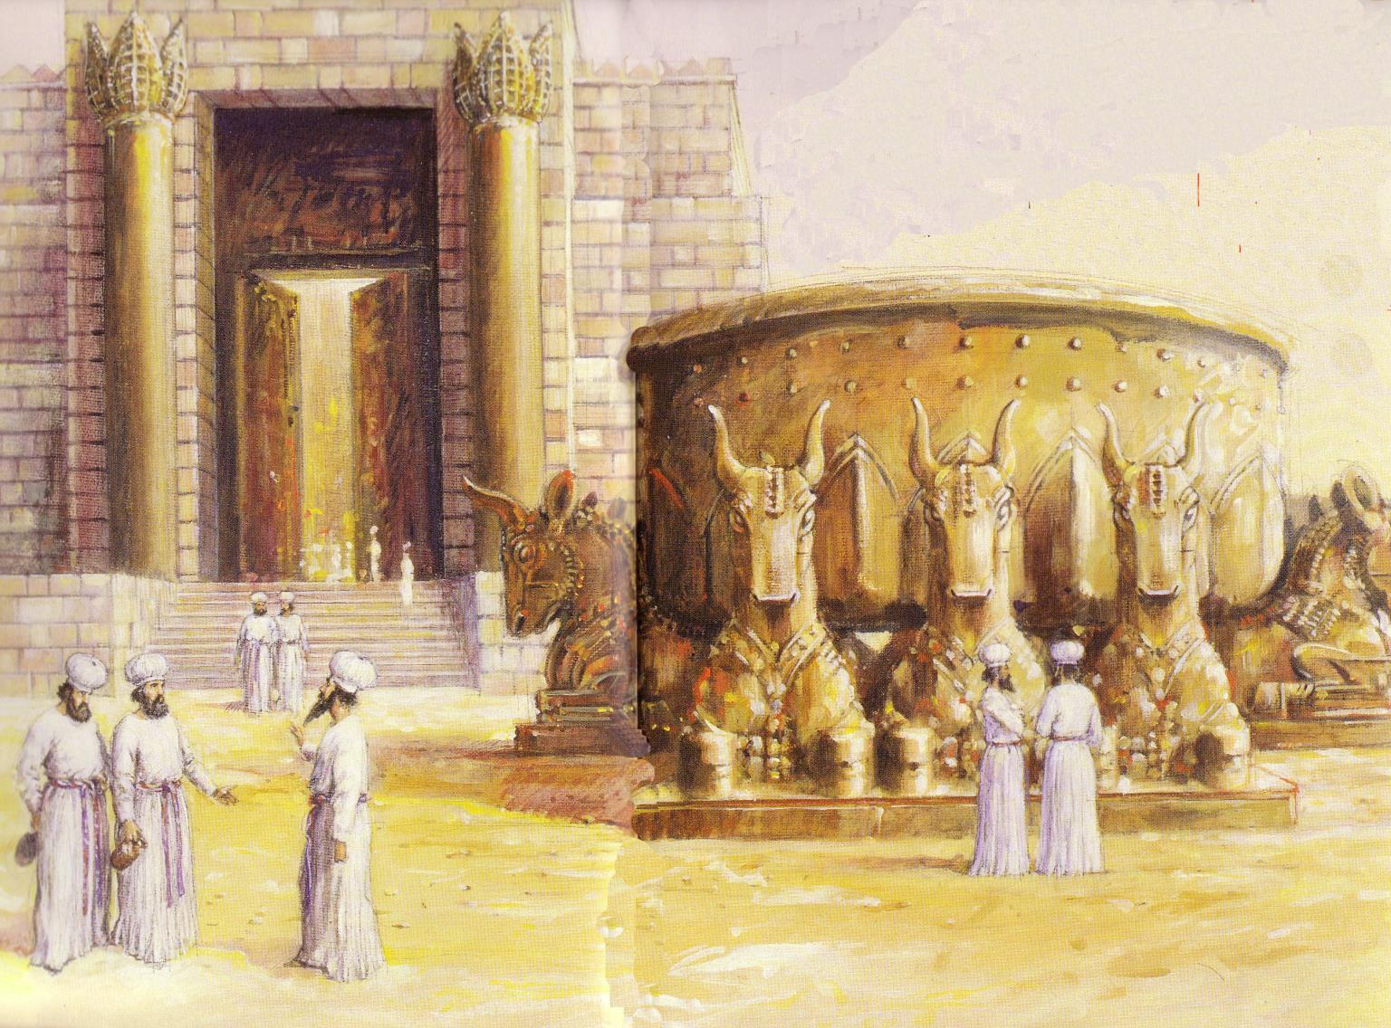
hqfoõjka mdmh ;=< rod mej;=fkdah
foajud,s.dj úskdYùsu
9 wÄî
• 586 lzs(mq
• lzs(j 70

Slide 65
nhsn,fha wu;r ux.,Hh#2
180
1 ksika
2 bfh¾
3 isjka
4;ïuqia
5 wdí
6 t,q,a
7 ;sIars
8 u¾fniajdka
9 lsiaf,ú
10 fgfn;a
11 fInd;a
12 wo¾¾
mdial=j
ñosu
uqyqkakquqiq frdá
fjkaúu
mz:u t,
W;a:dkh
fmka;fldia;h
wd;auh
ykqld
rdcOdksh
l++vdrñ ux.,Hh
9th of Avu
miq;eú,a,
jkaos f.ùfu oskh
Tijd .ekSu
fyrKE yv
3 jkaokd ux.,Hhka

Slide 66
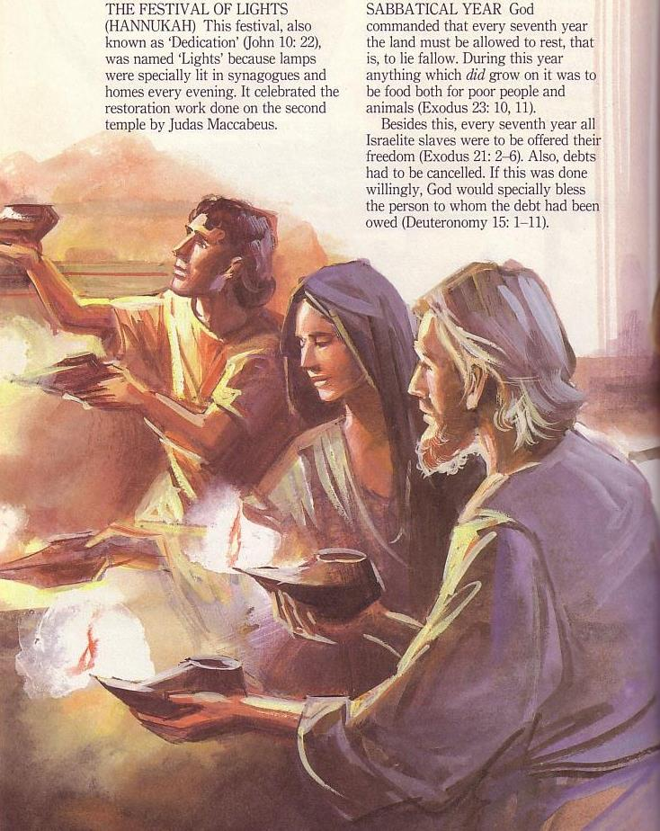



aykqld( ^wdf,dalfha ux.,Hh&) fi,qisÙjre mrdch l, hQodia ulîiaf.a ch.zykh ieursu 164 lzs(mq
184
7-w;= fnos.sh fufkdrd;a ( ^fkdlvjd&
(ykqld) 9-myka lkqj

Slide 67
nhsn,Sh wu;r ux.,Hhka#3
mQQ¦sñ
180
1 ksika
2 bfh¾
3 isjka
4 ;ñuqia
5 wdì
6 t,q,a
7 ;sIars
8 u¾fniajdka
9 lsiaf,õ
10 fgfn;a
11 fInd;a
12 wo¾¾r
mdial=j
ñosu
uqyqkakquqiq frdá
fjkaùu
mzz:u t,
W;a:dkh
fmka;fkia;h
wd;auh
rdcHh
l+vdrñ ux.,Hh
9th of Avu
miq;eú,a,
jkaos f.ùfu oskh
Tijd .eksu
fydrKe yv
3 jkaokd ux.,Hhka

Slide 68

mQ¦sï: ch.zyKh wysñ ùu
184

Slide 69
I. bYzdfh,ajre foúhka jykafia iu. Y+oaO jq .ukla r|d mj;ajd .;ay
182
A. ish,q hqfoõ mqreIhka foúhka jykafiaf.a wdYs¾jdoh ;u csú;j, mj;skq jia ux.,Hhka ;=klg iyNd.s jqy (kslauhdu. 23:14-19).
B. foaj wK jq in;a oji Y=oaO fldg meje;aúu ;=, foúhka jykafia iy bYzdfh,a jre w;r ;snq .súiqu ms<sìnq úh( ^31(12-17).

Slide 70

in;a oji
182

Slide 71

182
I. foúhka jykafia iu. Y=oaO .ukla mj;ajd .kq jia bYzdfh,ajre úfúl .;ay'
A. foúhka jykafia Tjqkaf.a csú;j, l, ish,q wdYs¾jdo isyslrkq jia iEu hqfoú mqreIhkau ux.,Hhka ;=klg iyNd.S jqy( ^kslauhdu. 23:14-19).
B. foúhka jykafiaf.a uQ,sl kshuh jq in;a oji mj;ajk ,os' bYzdfh,a jreka iu. jq foaj .súiqu bka ms<sìnq úh
C. in;a oskfha os .skakla oe,aúu mjd Y=oaO jq úfõlh lvlsrsuls (35:1-3).

Slide 72

II. Y=oaO jq ld,hka wmg wjYHh bka foúhka jykafiaf.a lzshdj wm csú; j, úoHudk fjhs
A. Y=oaO ld,h
B. bYardfh,ajre fuka wm;a Y=oaO jq jd¾Isl W;aijhkays r|d mj;skakg wjYHh
C. bYdfh,ajre fuka i;sm;d Y=oaO jq W;aijhkays r|d mj;skakg wjYHh

Slide 73

mzOdk woyi: Y=oaO úfõlhla .eksu!

Slide 74
fudkjdo j¾;udkfha iudklï we;s ls;=kq W;aijhka@
mdial=j
k;a;,
rd;sz fNdaPkh
wj.dykh ( ^iEu mqoa.,fhl= ioyd fuh tla jrla mukla is≥ flf¾&

Slide 75

m%Yak idlÉPdj
1' wmg úfõlh ioyd ld,hla fkdue;s nj wms meñKs,s lrkafka l=ula ksido@
2' Tnf.a B<. ls;=Kq ux.,Hhka jvd;a úfõlSj iy wd;añl jkafka flfiao@
3' l=uk ud¾.hloS o foúhka jykafia Tng mjikafka Y=oaO jq úfõlhla iod.eksug@

Slide 76
bY%dfh,fha Y=oaO jq le,ekavrh
mQrSï
180
1 ksika
2 bh¾
3 isjdka
4 ;ïuqia
5 wdì
6 t,q,a
7 ;sIars
8 u¾fniajdka
9 lsiaf,õ
10 fgfn;a
11 fInd;a
12 wo¾
YS; R;=j
hqfoõ mdial=j
.e<ùu
uqyqka fkdfhÿ frdá
fjkaùu
mz:u t,,
W;a:dkh
fmka;fldia;
wd;auh
ykqld
.zSIau R;=j
rdcOdksh
;djld,sl jdiia:dkh$l+vdru
9th of Av
mYap;a;dmh
jkaos f.ùfï oskh
uy;a m%fudaoh
fydrKE yv
jkaokd ux.,Hhka 3

Slide 77
Black

Slide 78


නව ගිවිසුම් පසුබිම සදහා ලින්ක්: BibleStudyDownloads.org
මෙම ඉදිරිපත් කිරීම නොමිලයේ ලබා ගන්න!
Notes:
NT Backgrounds (nb)

